Slide 1
Version Control System

Slide 2

Agenda
VCS Philosophy
Types of VCS
30K feet view of VCS flow
Tooling landscape
Trends

Slide 3
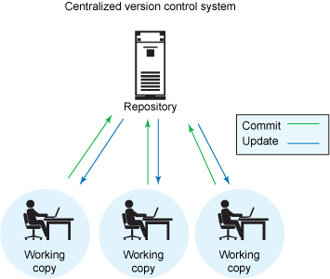
Why VCS
Individual
Backup methodology
Increments – know which version is live
Point in time marking aka. Tagging
Branching – release versions maintained & main development can continue
Team
Allow multiple developers (in remote locations) to work on same code base
Merge changes across same files – handle collisions
Answer who did what – blame / praise

Slide 4
Types of VCS
Centralized VCS:
Centralized version control systems (CVCS) focuses on synchronizing, tracking, and backing up files.
Distributed VCS:
Distributed version control systems (DVCS) focuses on sharing changes; every change has a guid or unique id.

Slide 5
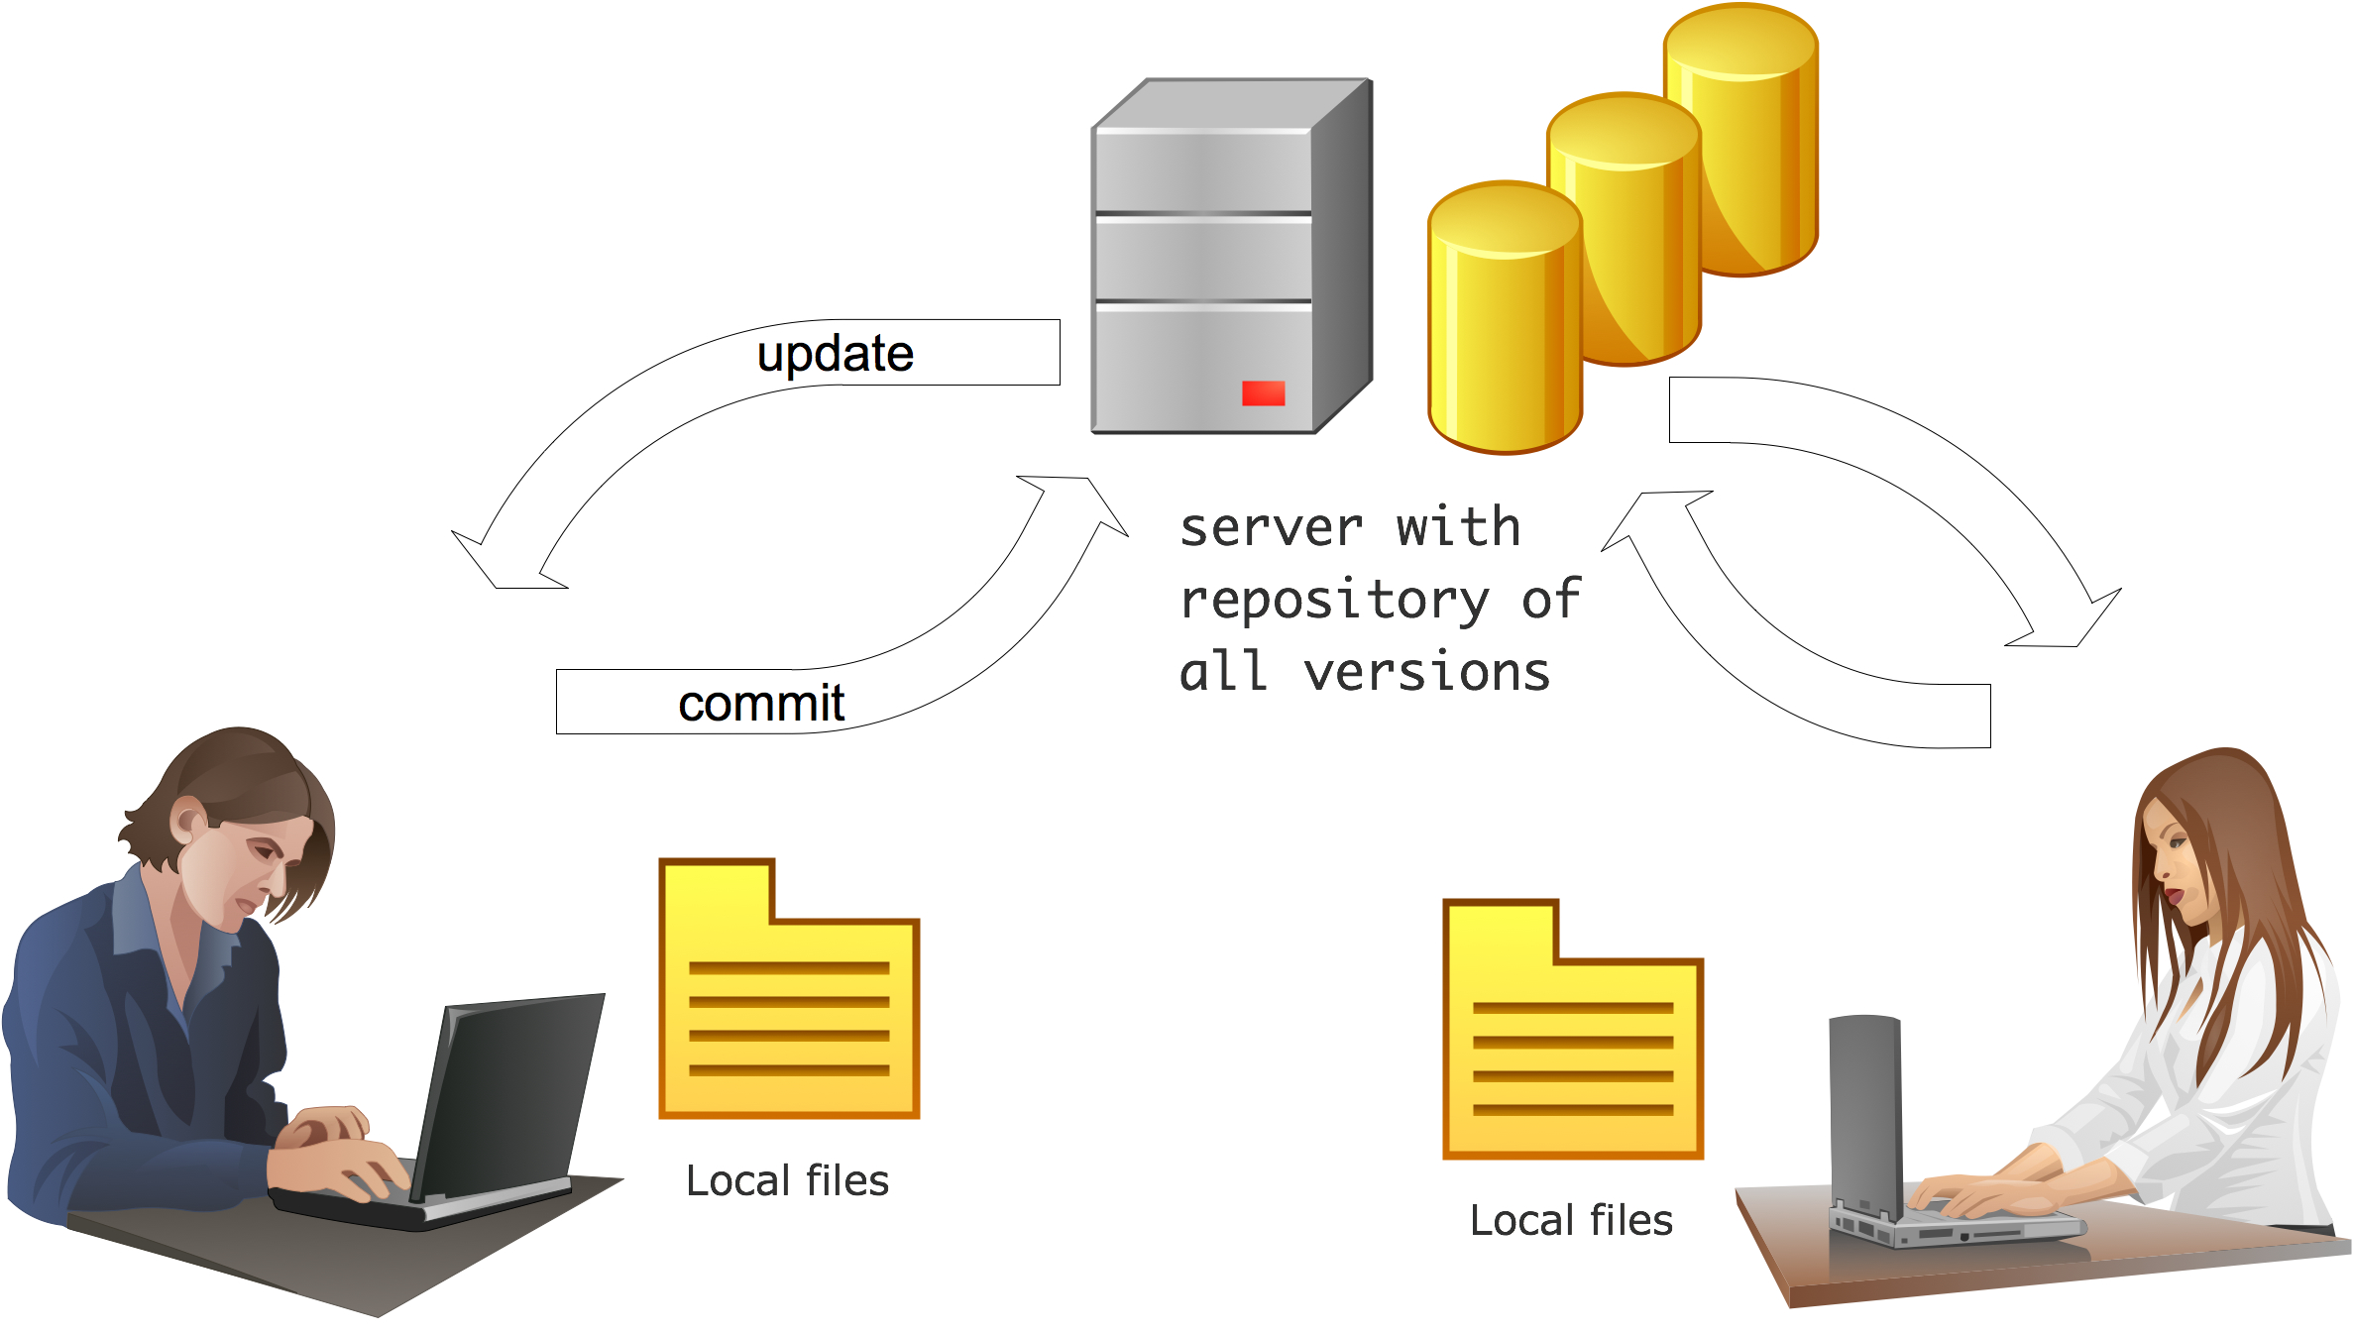
VCS flow

Slide 6






Tooling Landscape

Slide 7
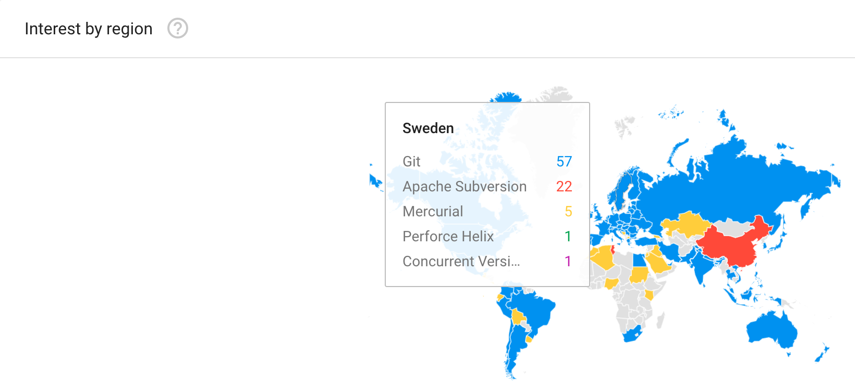
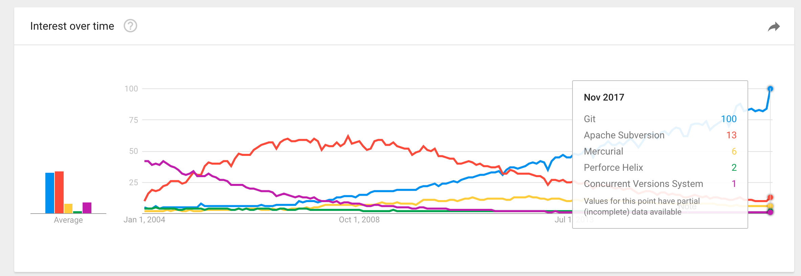
Trends
Notes:
https://rhodecode.com/insights/version-control-systems-2016

